Slide 1











Exploration of Amazon’s Co-Purchase Network
Presentation by: Dhairya, Harsh, Divyansh
IIITD

Slide 2

INTRODUCTION
This project focuses on analyzing a real-world co-purchase network derived from product purchases.
Each node represents a product, and a directed edge represents a co-purchase relationship.
The study includes:
Topological characterization of the network
Community detection
Scale-free and small-world analysis
Predictive modeling to forecast co-purchases

Slide 3
Dataset Description
We have taken the datasets from Amazon Copurchase dataset, which contains two files products.csv and copurchase.csv.
Product Metadata (products.csv):
Contains detailed metadata for a collection of products, primarily books and music.
Key attributes include: product ID, title, group (category), sales rank, review count, rating, downloads, etc.
Product Co-purchase Network (copurchase.csv):
Represents a directed graph structure of co-purchase relationships between products.
Each row contains:
Source: The product ID of the primary item being purchased.
Target: The product ID of another item frequently co-purchased with the source item.
Dataset Statistics:
Nodes: 310,771
Edges: 915,666
Average degree: 5.89
Maximum degree: 384
Minimum degree: 1

Slide 4
Structural and Topological Analysis of the Co-Purchase Network:
Compute Degree Distribution and visualize it using a log-log plot.
Average Clustering Coefficient to measure product co-purchase tendencies.
Assortativity to evaluate degree correlation between products.
Identify Strongly/Weakly Connected Components to understand product groupings.
Comparison with a Random (Erdős–Rényi) Network of the same size to assess network properties.
Community Detection and Modularity Analysis:
Analyze Community Structure: Investigate if products (e.g., books) are grouped together based on co-purchase behavior.
Visualize Top Communities: Identify and visualize the most central products within these communities.
OVERVIEW OF OUR WORK

Slide 5
Scale-Free & Small-World Nature Investigation:
Evaluate Scale-Free Behavior through power-law fitting to understand network degree distribution.
Measure Small-World Characteristics by analyzing the average shortest path length and clustering coefficient.
Plot Degree Distributions and Cumulative Degree Distributions to further confirm scale-free behavior.
Predictive Modeling for Co-Purchases:
Use Classifiers (e.g., Logistic Regression or Random Forest) to predict if a pair of products will be co-purchased.
Evaluate using ROC-AUC and Precision-Recall Metrics to measure model performance.
Interpret Future Co-Purchases: Highlight the most likely future co-purchase recommendations.
OVERVIEW OF OUR WORK

Slide 6
Structural and Topological Analysis
03
Assortativity coefficient
In this section, we analyze the co-purchase network's structure and topology using the following methods:
04
Identifying connected components
01
Degree distribution and log-log plot
05
Comparison with a random Erdős–Rényi network of the same size
02
Average clustering coefficient

Slide 7


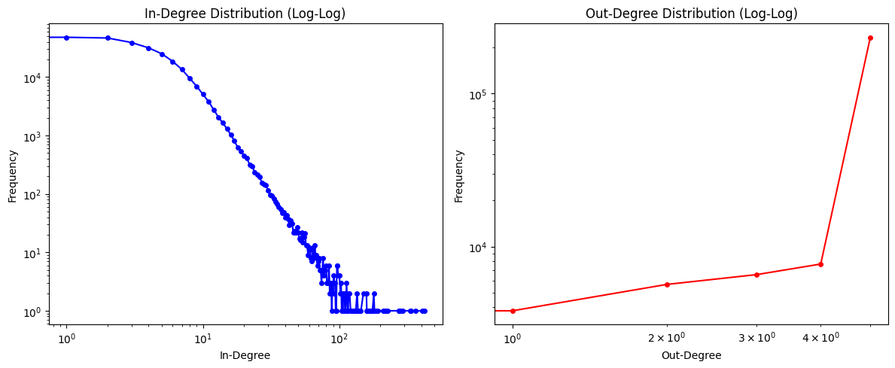


Degree Distribution (Log-Log Plot)
Objective
To assess how product popularity is distributed in the network.
We compute the in-degree and out-degree distributions to understand product popularity.
Result: The log-log plot reveals a long-tail distribution, indicating that a few products are highly popular while the majority are less popular..

Slide 8
Average Clustering Coefficient
Objective
To measure the clustering tendency of products being co-purchased together.
Result
The average clustering coefficient is 0.4198, indicating a relatively high tendency for products to form dense
clusters of co-purchased products.

Slide 9
Assortativity
Objective
To evaluate if products with similar degrees (popularity) tend to connect.
Result
The assortativity coefficient is -0.0025, suggesting the network exhibits disassortative mixing, meaning products with higher degrees tend to connect to those with lower degrees..

Slide 10
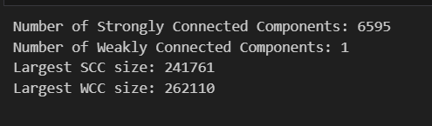
Connected Components
Objective
Identify strongly and weakly connected components in the network.
Result
Strongly Connected Components (SCC): 6,595 SCCs, with the largest SCC containing 241,761 nodes.
Weakly Connected Components (WCC): 1 WCC containing 262,110 nodes.
The largest weakly connected component includes most of the nodes in the network, suggesting that the network is well-connected.

Slide 11
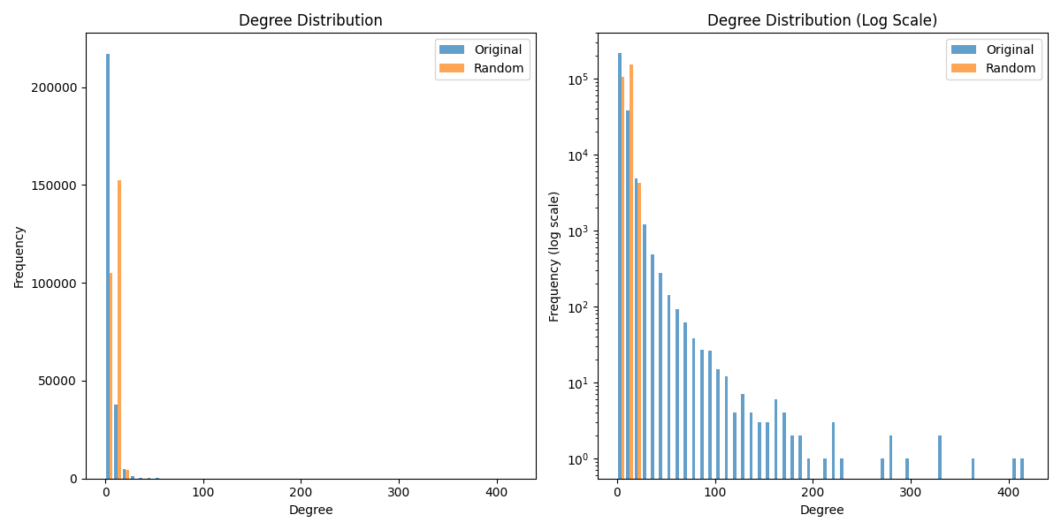
Comparison with Erdős–Rényi Random Graph
Objective
Compare the co-purchase network with a random Erdős–Rényi network of the same size (same number of nodes and edges).
Results
Real Network: Higher clustering coefficient, longer path lengths, indicating a small-world structure.
Random Network: Lower clustering coefficient and shorter path lengths.
Key Insights
The real co-purchase network exhibits a much more clustered structure than a random network and has longer path lengths.

Slide 12
Community Detection and Modularity
Objective
Detect communities within the co-purchase network and analyze their modularity.
Method
Community detection was performed using the Louvain method on the largest connected component of the undirected co-purchase network.
Results
164 communities detected.
Modularity score: 0.9016, indicating strong community structure.

Slide 13
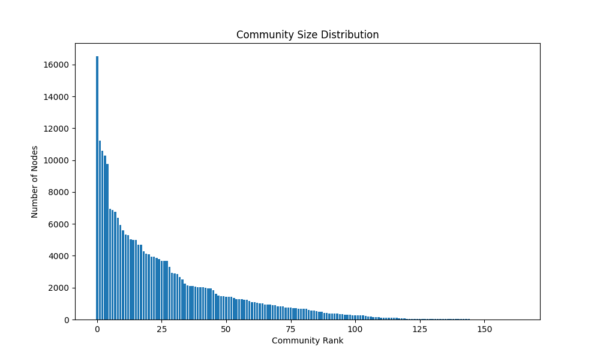
Community Visualization
Objective
Visualize the top communities and identify central products within them.
Results
The largest community (Community 10) contains 16,517 nodes.
Top central products in the largest community include Product ID: 1241, 3661, 9131, 3673, 1964.
Insight
Communities reflect thematic or category-based groupings, such as books from similar genres.

Slide 14
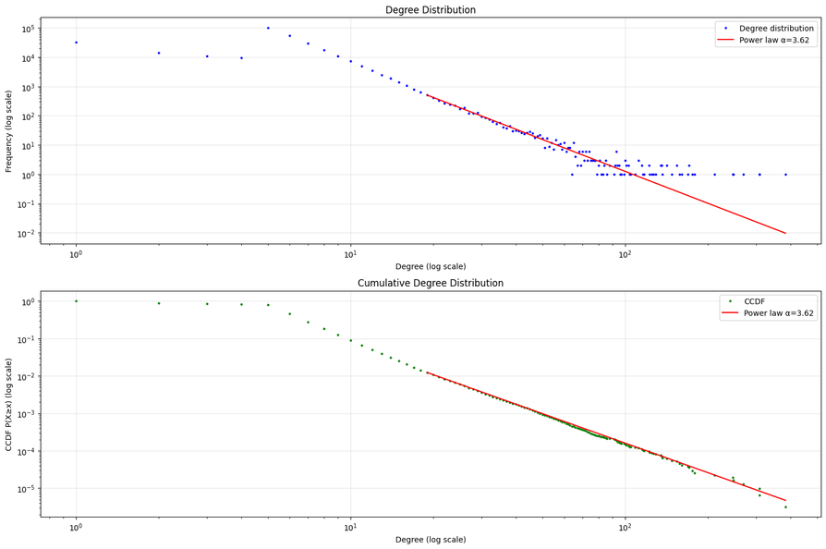
Scale-Free Properties
Objective
Investigate whether the co-purchase network follows a power-law (scale-free) degree distribution and exhibits small-world characteristics.
Power-Law Degree Distribution
Power-law exponent (α): 3.6179
Minimum degree: 19
Log-likelihood ratio (vs. log normal) : -0.0698
p-value: 0.8385
Key Insight
Degree distribution is heavy-tailed, suggesting scale-free tendencies.
Degree Distribution: The log-log plot shows a clear power-law relationship, indicating scale-free properties.
Cumulative Degree Distribution (CCDF): The network follows the power-law distribution, reinforcing the scale-free nature

Slide 15
Small-World Properties
Objective
Determine if the network exhibits small-world properties by analyzing the largest connected component (LCC).
Key Metrices
Average shortest path length: 9.8852
Average clustering coefficient: 0.3647
Random graph clustering coefficient: 0.0000
Clustering ratio (Original / Random): 11,397.82
Random graph path length: 5.8097
Path length ratio (Random / Original): 0.5877
Key Insights
The network exhibits small-world properties:
High clustering and short path lengths are characteristic features.
Clustering coefficient is far greater in the original network compared to a random network.
Path length ratio shows the network is still quite efficient, but with more localized clustering.

Slide 16
Predictive Modeling for
Co-Purchases
Objective
Use machine learning models to predict whether a pair of products will be co-purchased in the future.
Process
Feature Extraction: Sales rank difference, preferential attachment, common neighbors, Jaccard coefficient, etc.
Classification Models: Random Forest, Logistic Regression, Gradient Boosting, Neural Network, and K-Nearest Neighbors.

Slide 17
Classification Model Performance
Evaluation Metrics
Accuracy, Precision, Recall, and F1-Score were computed for each model.
Model | Accuracy | Precision | Recall | F1 Score | AUC
GB | 0.6827 | 0.6652 | 0.7664 | 0.7122 | 0.7935
LR | 0.6693 | 0.7959 | 0.4769 | 0.5964 | 0.7920
RF | 0.6763 | 0.6809 | 0.6929 | 0.6869 | 0.7805
NN | 0.5410 | 0.8150 | 0.1347 | 0.2312 | 0.5657
K-NN | 0.4993 | 0.5121 | 0.4834 | 0.4973 | 0.5087

Slide 18
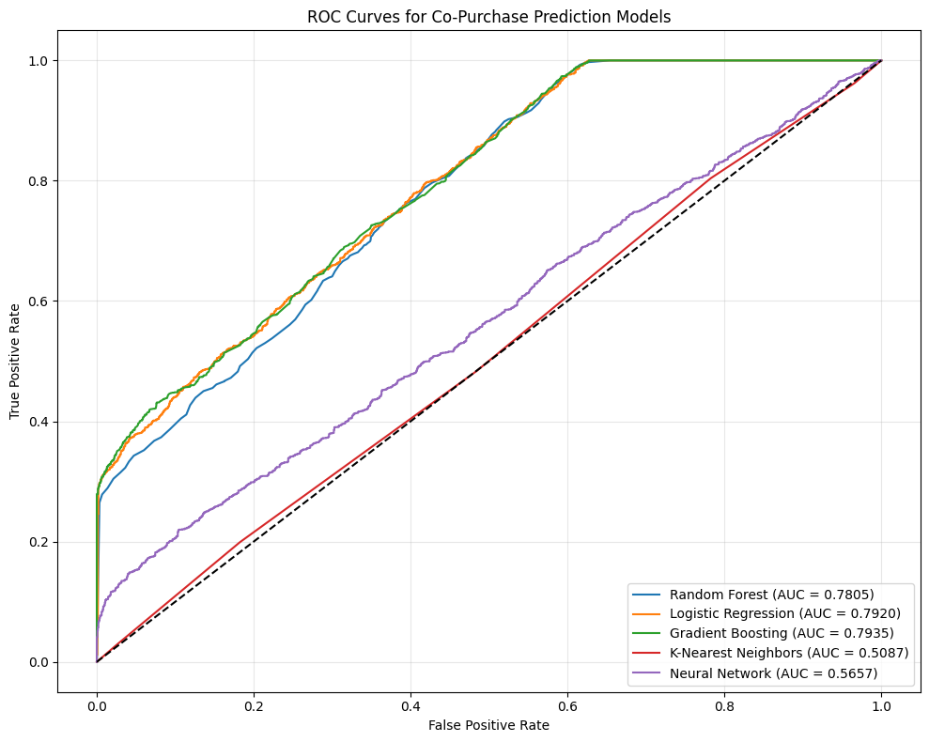
BEST MODEL
Gradient Boosting (GB) with an AUC score of 0.7935, followed by Random Forest (RF).

Slide 19
Co-Purchase Prediction
Objective
Predict the likelihood that two products will co-purchase in the future.
Method
Feature vectors are computed for each product pair.
The feature vector is passed to the pre-trained machine learning models for prediction.

Slide 20
Co-Purchase Prediction
Feature | RF | LR | GB
Preferential Attachment | 0.7001 | 0.610 | 0.150
Adamic-Adar Index | 0.0876 | 0.120 | 0.150
Jaccard Coefficient | 0.0665 | 0.080 | 0.150
Common Neighbors | 0.0644 | 0.070 | 0.150
Salesrank Difference | 0.0410 | 0.070 | 0.150
Resource Allocation Index | 0.0338 | 0.040 | 0.150
Rating Product | 0.0066 | 0.010 | 0.150
Output
The model returns a probability score between 0 and 1 indicating the likelihood of future co-purchase.

Slide 21
Co-Purchase Recommendation
Objective
This section recommends future co-purchases based on a selected book. It suggests products that have a high likelihood of being purchased together, expanding the possibilities of future product bundling.
Method
Users select a book to get recommendations for potential co-purchases.
The system computes the likelihood of other books being co-purchased with the selected book.
Top recommended books are displayed based on predicted likelihoods.

Slide 22
GUI Working of Prediction and Recommendation Tasks
Objective
Demonstrate the working of the co-purchase prediction and recommendation system via a graphical user interface (GUI).
Process
Users input two products for co-purchase prediction or choose a product for recommendations.
The system provides the predicted likelihood of co-purchase and recommends other products.

Slide 23
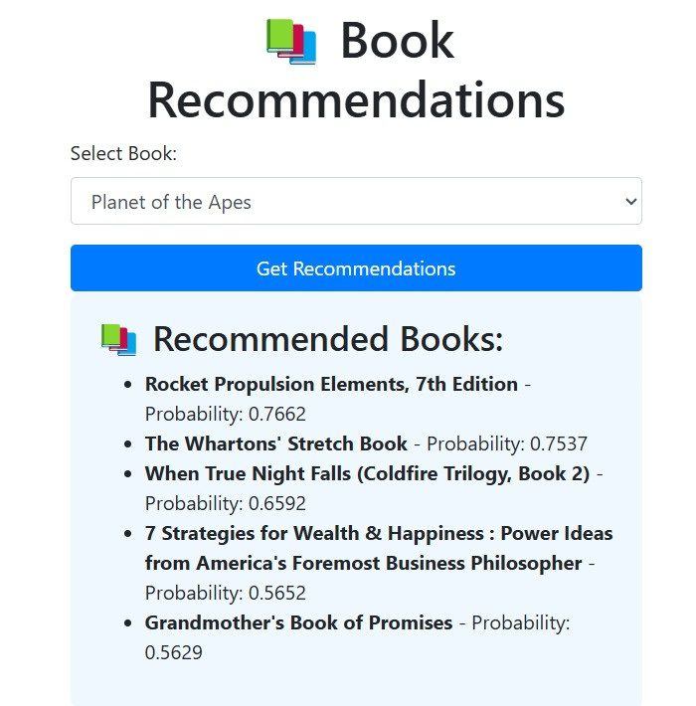
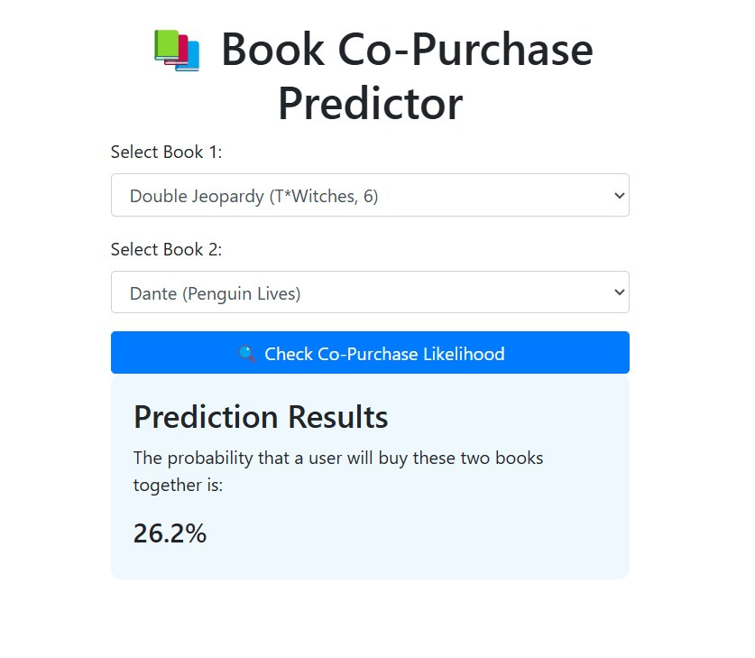
GUI Working of Prediction and Recommendation Tasks

Slide 24
Conclusion
The co-purchase network exhibits typical real-world complex network behavior, with characteristics like heavy-tailed degree distributions, community structure, and small-world properties.
Predictive modeling based on network structure and product metadata offers valuable insights into future co-purchase behaviors.
Future Work: Refining the models by incorporating more features and testing additional recommendation algorithms for better accuracy.

Slide 25
THANK YOU VERY MUCH!

